Slide 1


SAP Support - Customer Experience Team
Turning Information into Action
November 17, 2011 Pittsburgh BOUG Meeting

Slide 2
Customer Experience Team Mission
  To fully understand our customers’ experience with SAP Support in order to influence support programs and solutions
    4 main functions within Customer Experience exist so we can listen, engage, act, and influence based on our customers feedback
      Customer Feedback: Provide holistic view of feedback into Support organization so we can use data to influence change
      Usability: Observe customers as they interact with Support in order to improve the usability of applications and services
      Customer Insight: Personalized demonstrations with customers to ensure they have the necessary education to function within the SAP Support Portal
      Customer Liaison: Build community with our customers to engage, share, and communicate in regards to SAP Support
Customer Feedback
Customer Experience
Customer Liaison
Usability
Customer Insight

Slide 3

Listening, Influencing, Changing
Customer engagement making a difference
  Our customers talk to us and we listen.
  Based upon conversations, feedback, and usability studies, our customers have helped us identify the areas that affect them the most. They have provided ideas and suggestions to improve, and we have taken these and influenced change within support.
  All of the changes and planned changes to our tools, processes, and applications have derived directly from our customers.

Slide 4
Improvements to the Customer Experience
Current updates
  Software Downloads
    Notifications of Address Directories, Service Packs, and Fix Packs
    Re-organized area for Business Analytics downloads
    Links within Download to the Product Availability Matrix, Maintenance Dates, and Supported Platforms
    Full product version names available
  Enterprise Support
    Checklist of Enterprise Support Offerings for BusinessObjects customers
  Tips and Tricks
    Page on SCN dedicated for Customer Support Tips and Tricks
Future updates
Message Wizard/Component Selection
  Redesign of the Message Wizard and Component Selection areas of the SAP Support Portal
License Key contractual overview
  Provide contractual overview of licenses owned by customer in SAP Support Portal
Enterprise Support collateral
  Map customer job/role to the appropriate Enterprise Support offering that will benefit them the most

Slide 5

Current Updates

Slide 6
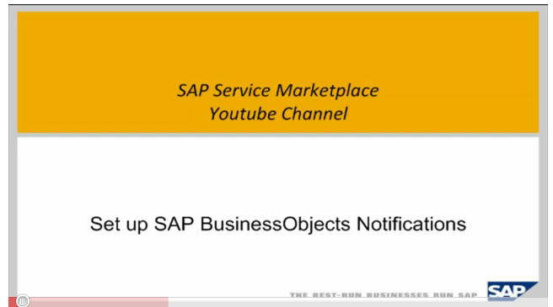
Current Updates – Software Download
Notifications of address directories, service packs, and fix packs
Users can now register to be notified via email or text when a software release is available to download. Check out the short how to video below or reference Knowledge Base Article 1553034

Slide 7
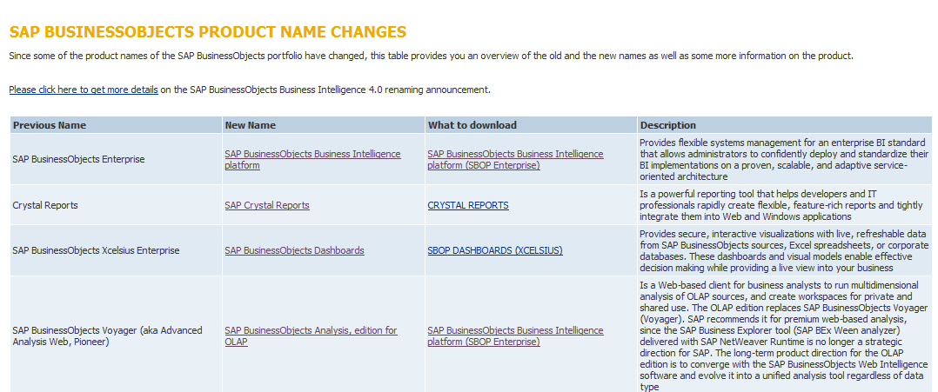
Current Updates – Software Download
Re-organized area for BusinessObjects downloads
A special re-organized area for BusinessObjects downloads is available. For easy access to SAP BusinessObjects software, customers can go to http://service.sap.com/sbop-downloads. Recent product brand name changes are also visible, allowing customers to view and access the right product and download easily.

Slide 8
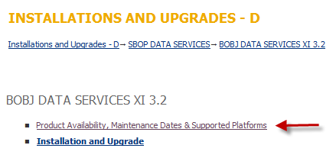
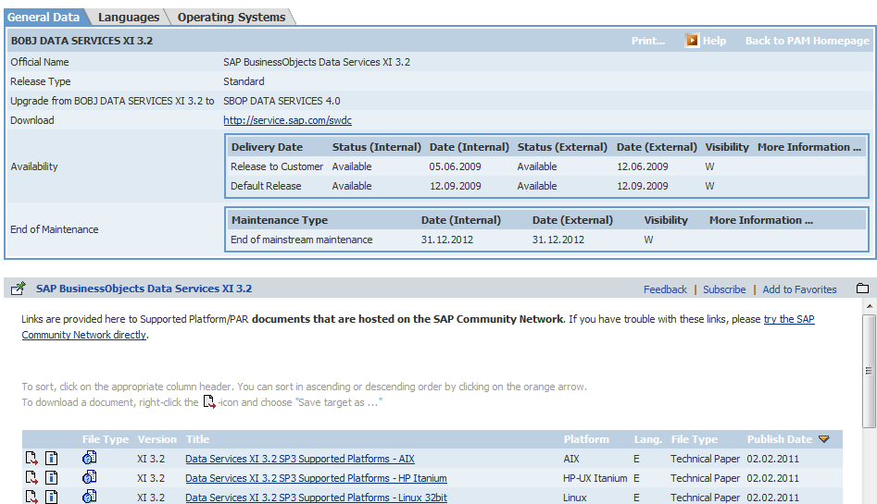
Current Updates – Software Download
Links within downloads to PAM, maintenance dates, and supported platforms
A link leading to the Product Availability Matrix, maintenance dates for products, and supported platform information is now available under product version downloads. This change makes it easier to find this important information for customers.

Slide 9
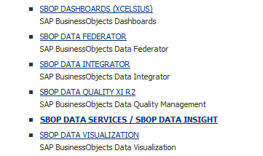
Current Updates – Software Download
Full product names now visible in downloads
Full product and product version names now appear alongside SAP acronyms. These full names can be used to search for your product as well. A great enhancement making it easier to find your product.

Slide 10
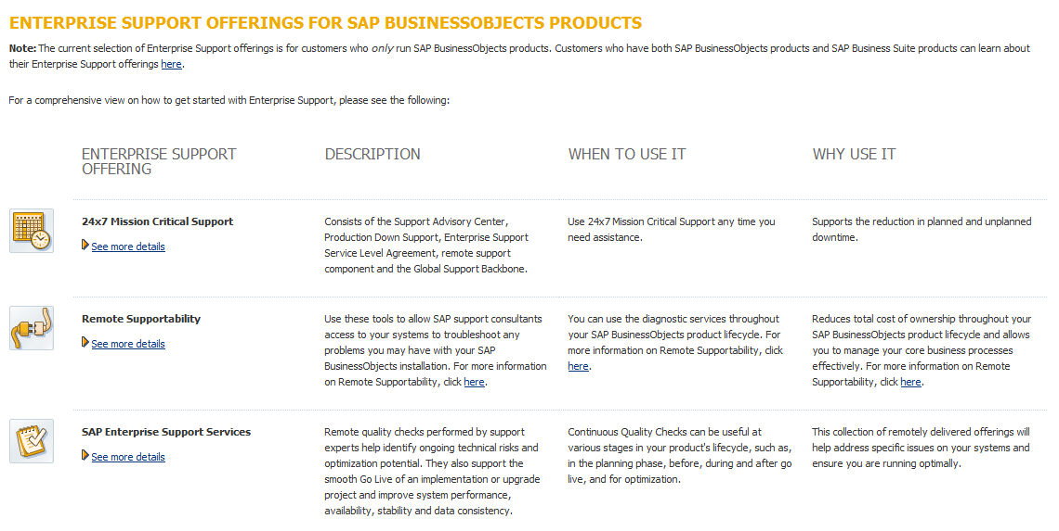
Enterprise Support Collateral for BusinessObjects customers
Checklist created to make finding the right service easier
Checklist of all Enterprise Support services and offerings available for BusinessObjects customers, a short description sharing how they can best leverage Enterprise Support, and the benefits gained from each offering.
Notes:
Based on customer research, the Customer Experience team worked in conjunction with our internal Education, Sales, Marketing, and Enterprise Support teams to create clear and concise collateral where our SAP Business Analytics customers can find out more about Enterprise Support. The result of this collaboration is an infopage which lists all Enterprise Support services and offerings, a short description about how they can best leverage Enterprise Support, and the benefits gained from each offering. This overview of all Enterprise Support offerings is directed towards SAP Business Analytics only customers, and went live on September 22nd.

Slide 11
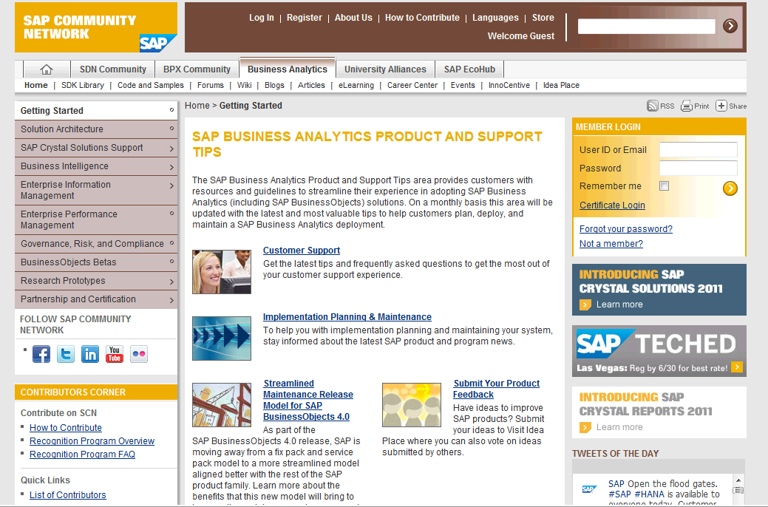
Tips and Tricks on SDN for BusinessObjects
Valuable tips for product and support
Informative and valuable content available that provides SAP BusinessObjects customers with guidelines for product and support usage

Slide 12
Future Updates

Slide 13

Influencing change in SAP Support – Future Changes
Planned/In Development
Enterprise Support collateral available for all SAP customers that will map customer job roles to most beneficial services and offerings – ETA Q4 2011
License Key contractual overview feature added to application page in SAP support portal – ETA Q1/Q2 2012
SAP Router and Software Downloads usability study to be completed by end of Q4 2011/Q1 2012
Message Wizard/component selection redesign to make the search and message creation functions easier. Implementation to begin in Q2 2012

Slide 14
Future Updates – Message Wizard/Component Selection
Redesign of the Message Wizard and Component Selection process
Why a redesign?
  After the message wizard usability study last year, it was determined that the message creation process is a challenge for SAP customers
  What is the goal?
  The goal is to make the overall process simpler. Less choices to filter through and easier access to create technical support issues are two of the main goals of this initiative.
  Expected Outcome
  By simplifying the way our customers log messages, we will improve overall usability, time to resolution on messages, our total processing time, and minimize issues not resolved.

Slide 15
Future Updates – License Keys
Contractual overview of products under customer agreement
Why add a contract view?
After the license key usability study that was completed in early Q2 2011, it was determined that our customers need a better understanding and view of what their company has purchased, and what they have access to.
What is the goal?
By providing a contractual overview, this will help our customers by simplifying the process and understanding of License Keys.
Expected Outcome
This contractual overview would map customer numbers, installations, systems and products with versions and include an inventory of available (unused) keys for each product. This will simplify the view for the customer of what they have used and what they have available.

Slide 16

Want to be involved? We Want YOU!!!
  Help us improve your experience with SAP Support
    Become a Usability participant!
      Find out how to participate by looking at our Usability FAQ
      Send your name, S-user ID, company name/number, email, and time zone to supportusability@sap.com
    Keep submitting PCC survey responses
      We monitor and track these responses so we can influence internal teams
    Coming Soon: Twitter account

Slide 17
Thank You!
Contact information:
Kristen Scheffler
Customer Liaison and Communications Manager
SAP America
407-417-2415
kristen.scheffler@sap.com
Twitter: @krscheffler

Slide 20
The Grid
Headline area
White space
Drawing area

